Slide 1

Mapping Global Biodiversity: Patterns, Trends, and Insights from GBIF Data
- Amit D. Dhumal – MT2409
(Advanced Python Programming)

Slide 2
Abstract
The project analyzes ~100,000 biodiversity observations sourced from GBIF.
Highlights patterns across kingdoms, continents, and decades.
Identifies biases such as uneven sampling and regional under-representation.
Uses diversity indices, spatial clustering, and forecasting to extract deeper insights.
Includes an interactive Streamlit dashboard for dynamic exploration.

Slide 3
Introduction
Biodiversity data is crucial for understanding species distribution, abundance, and ecological change.
GBIF is a global open-access repository containing millions of species occurrence records.
Challenges include incomplete taxonomy, sampling bias, geographic unevenness, and temporal inconsistencies.
Study objective:
Clean and preprocess ~100k records
Analyze taxonomic, geographic, and temporal patterns
Visualize insights and identify biodiversity hotspots and gaps.

Slide 4
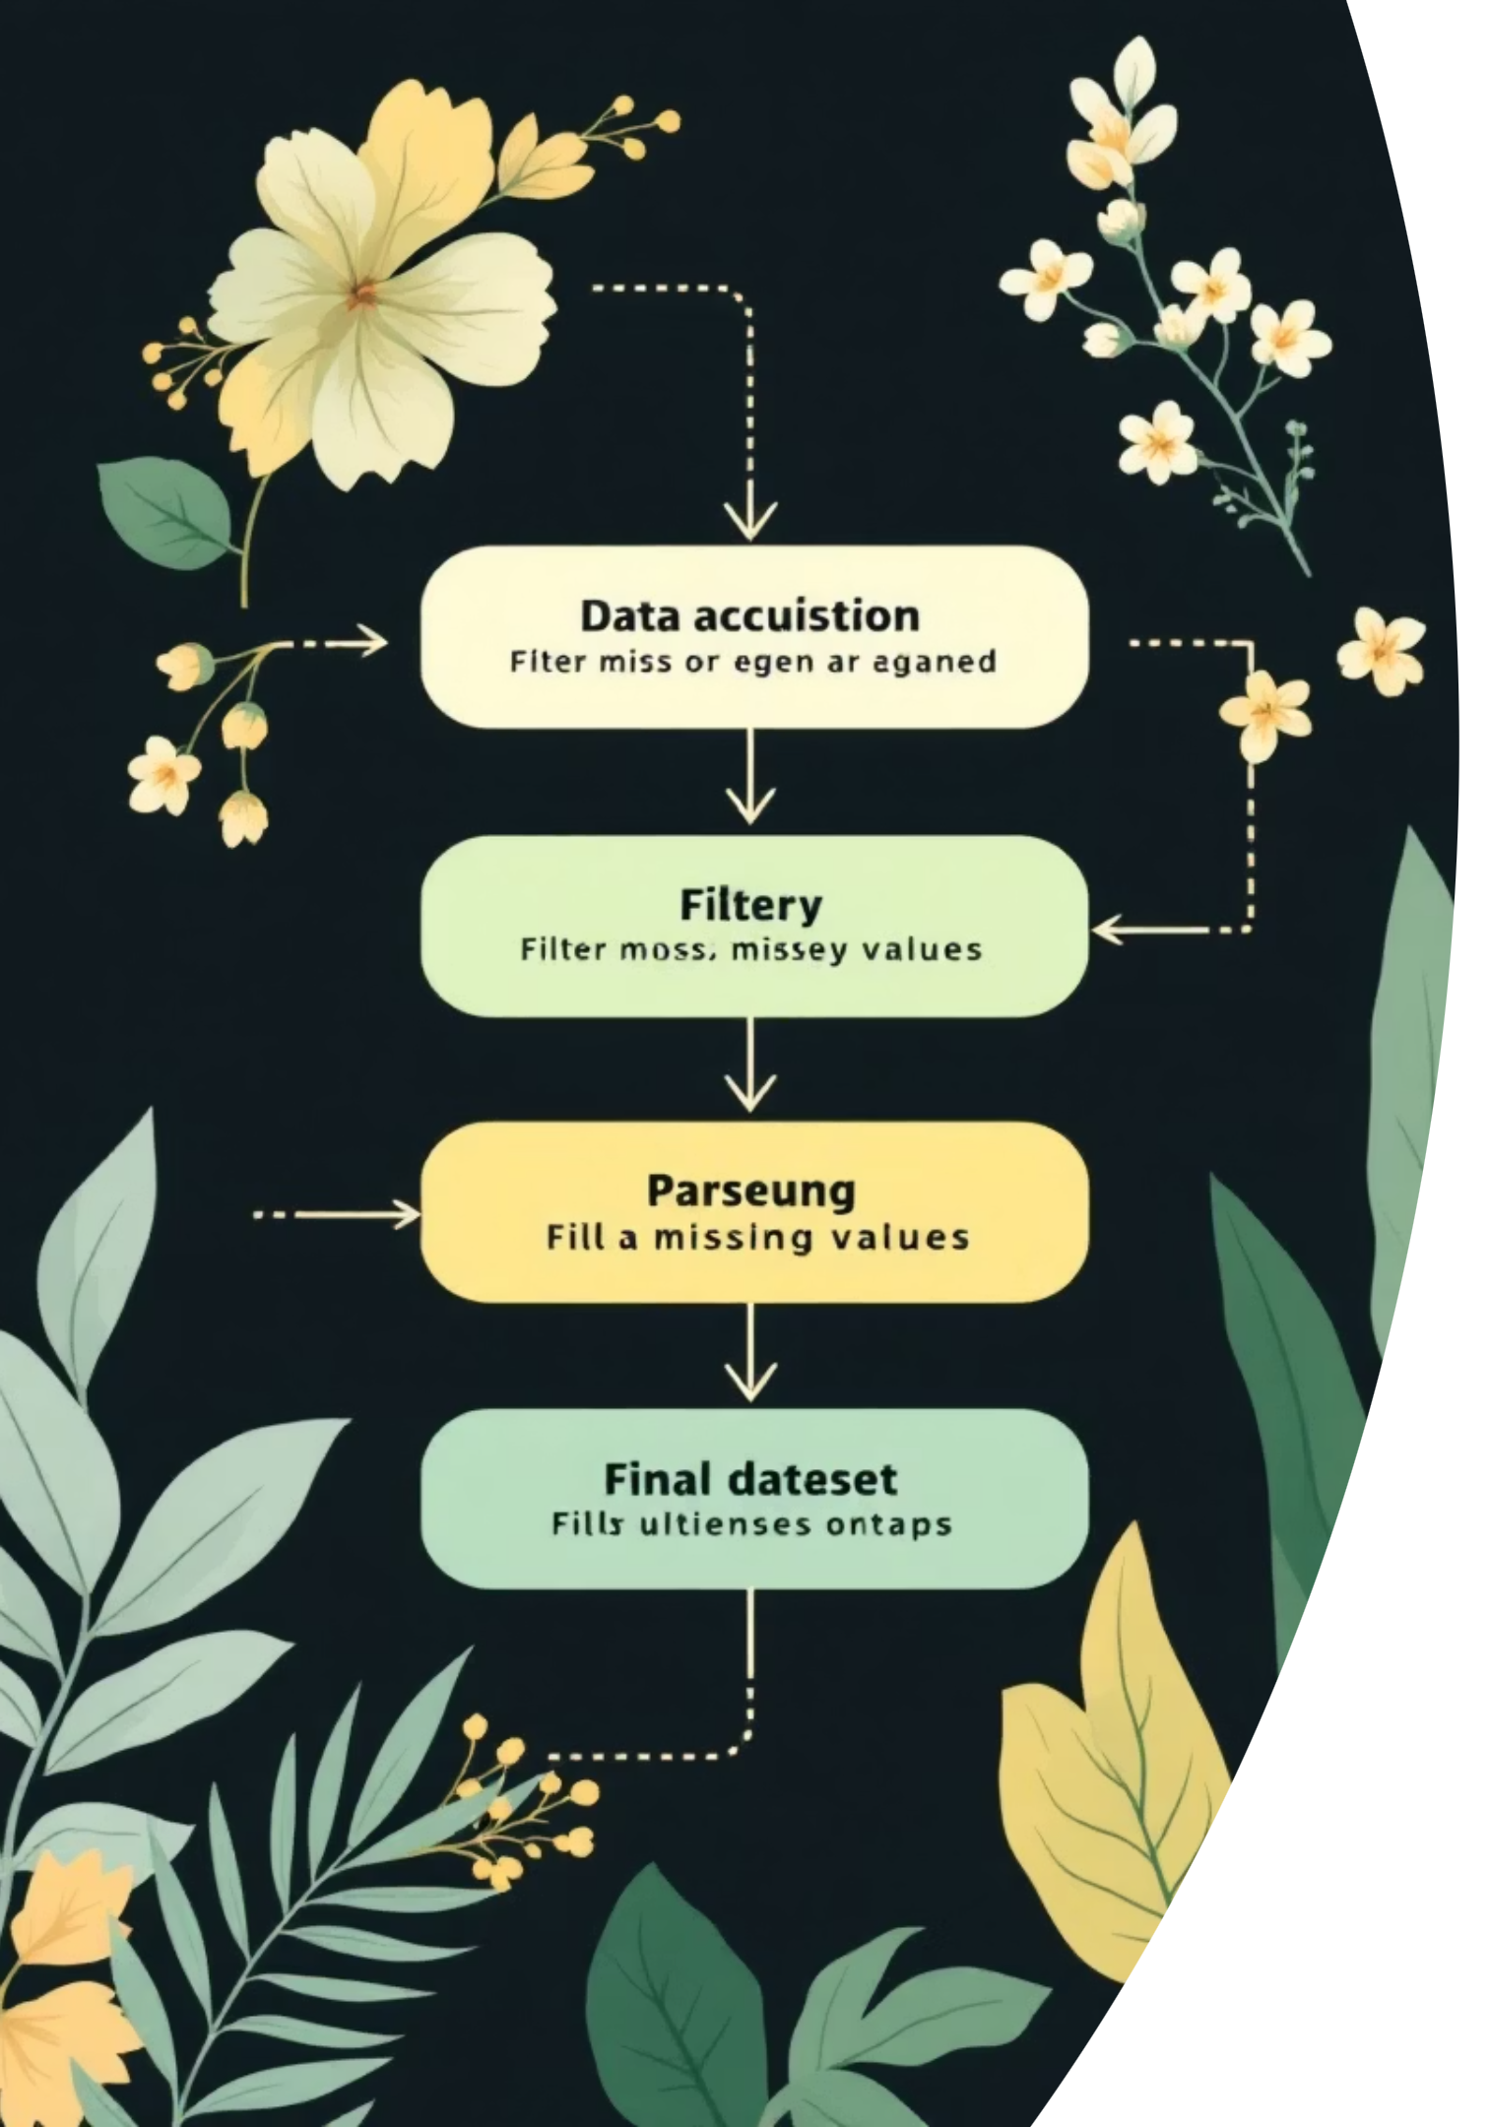
Methodology Overview
Data Acquisition & Cleaning
Exploratory Data Analysis (EDA)
Loaded dataset dataset 9.csv.
Removed missing/invalid coordinates.
Taxonomic distribution — Kingdom, Class.
Parsed dates into standard format.
Geographic distribution — Top countries.
Filled missing taxonomic values with Unknown.
Temporal trends — yearly, monthly.
Final cleaned dataset: 99,763 records.

Slide 5
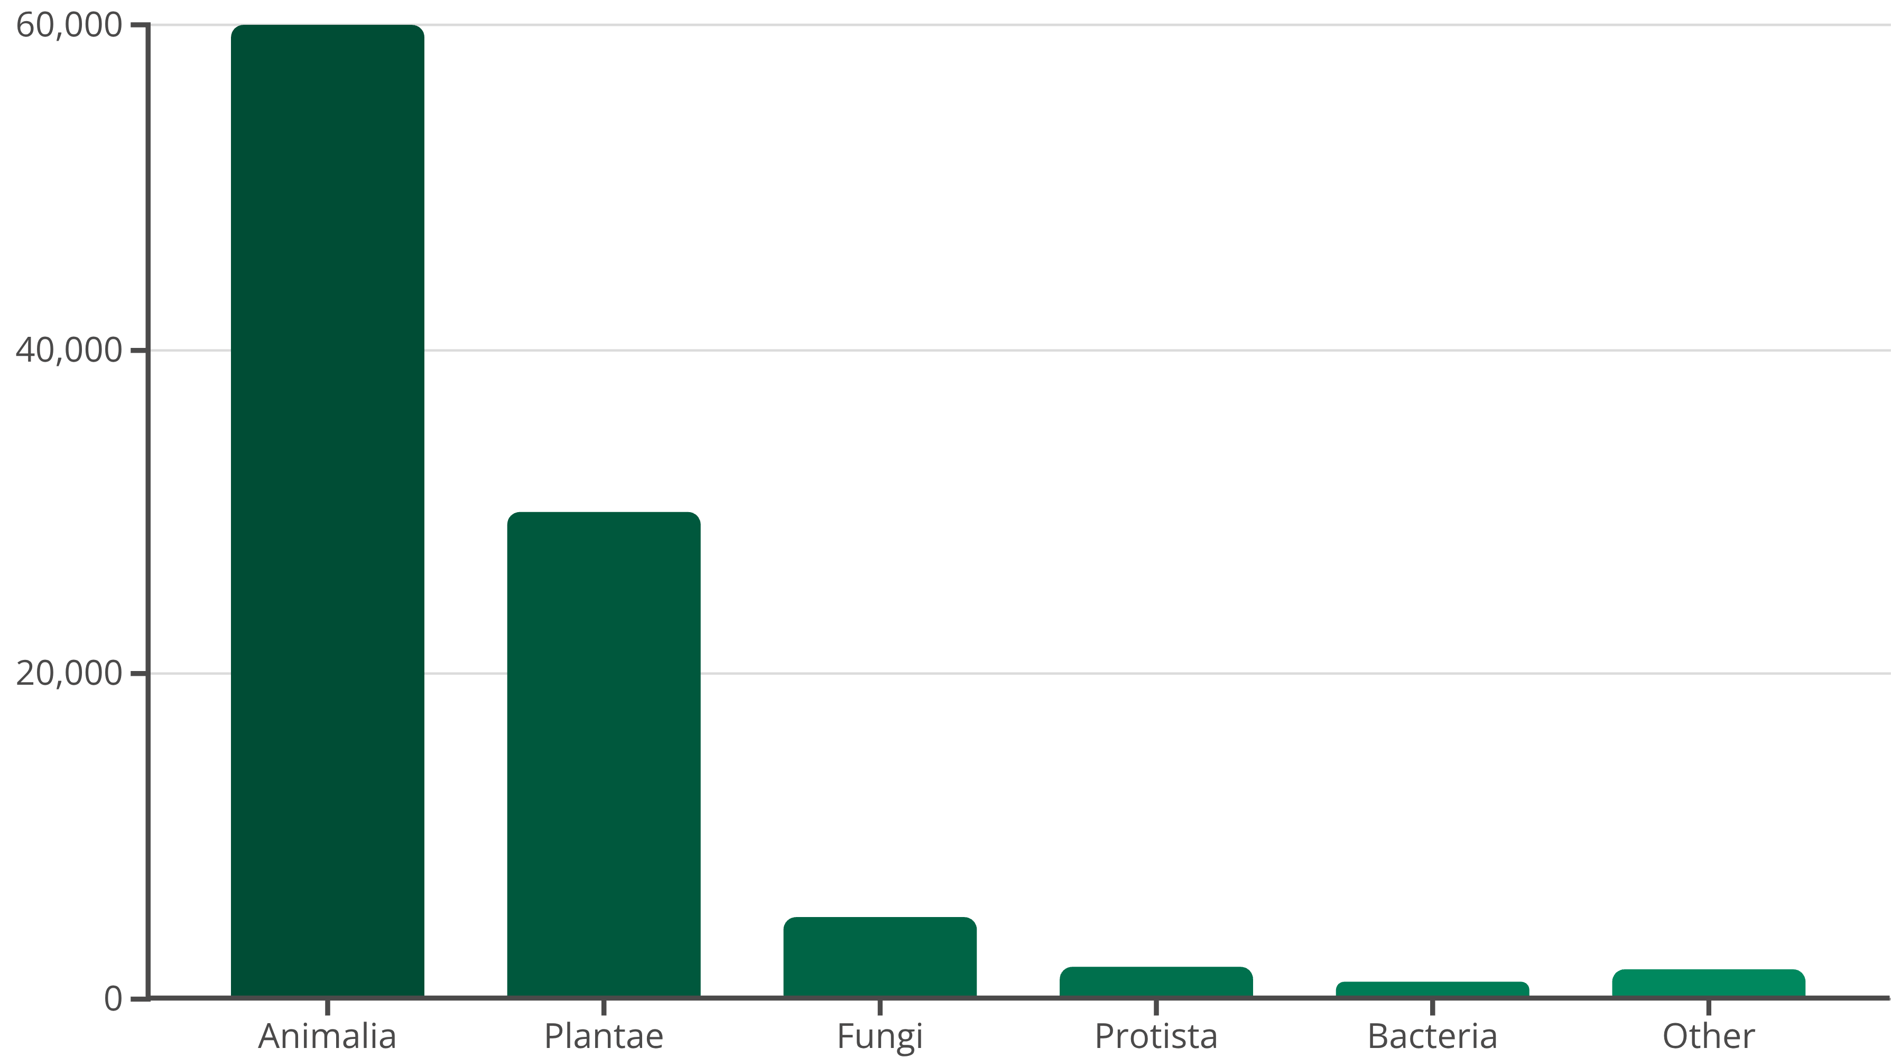
Taxonomic Distribution
Key Insight: Kingdom Animalia dominates the dataset, followed by Plantae. Fungi, Protista, Bacteria, and
others are minimally represented.
Figure 1: Distribution of Observations by Kingdom

Slide 6
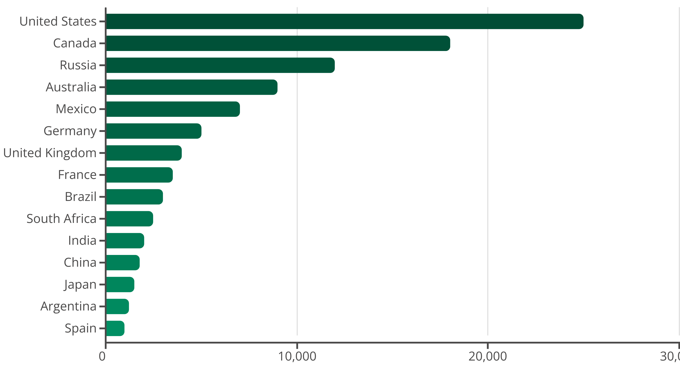
Geographical Distribution
Key Insight: Observations unevenly distributed across the world. United States, Canada, Russia, Australia, and Mexico contribute the most.
Indicates strong observer bias and data contribution bias.
Figure 2: Top 15 Countries by Observation Count

Slide 7
Temporal Trends
Key Insight: Observations rapidly increase after 2000. Sharp rise in recent years suggests
growing citizen science activity and improved reporting tools.
Figure 3: Yearly Observations (post-1900)

Slide 8
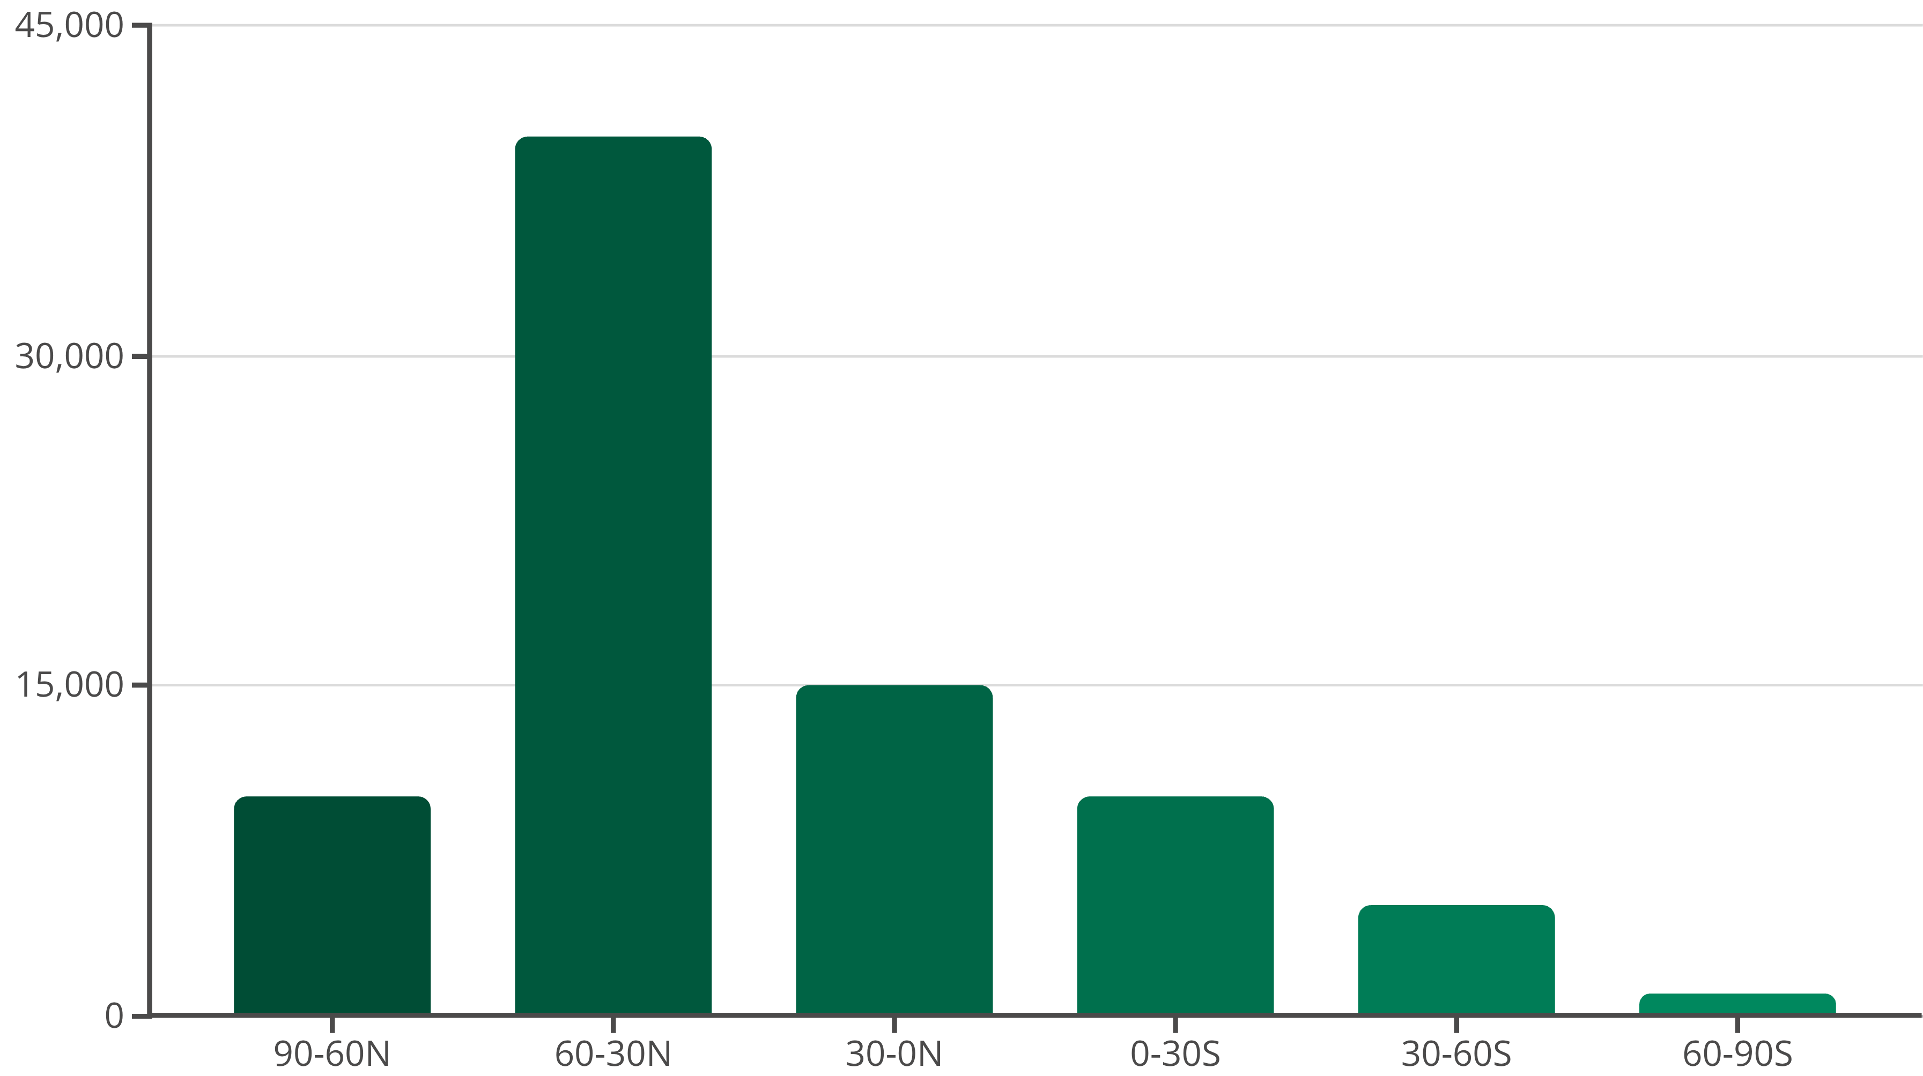
Data Story: Latitudinal Diversity Gradient
Key Insight: Classic ecological pattern: species richness increases from poles to tropics. Dataset shows
concentration in northern mid-latitudes.
Decline near equator indicates under-sampling of tropical biodiversity hotspots.
Figure 4: Distribution of Observations by Latitude

Slide 9
COVID-19 Era Biodiversity Monitoring
Key Insight: Analysis from 2018–2023. Contrary to expectation, 2020 shows no decline. Increased “backyard
science” during lockdowns likely sustained observations.
Figure 5: Observation Trends During COVID-19 Era

Slide 10
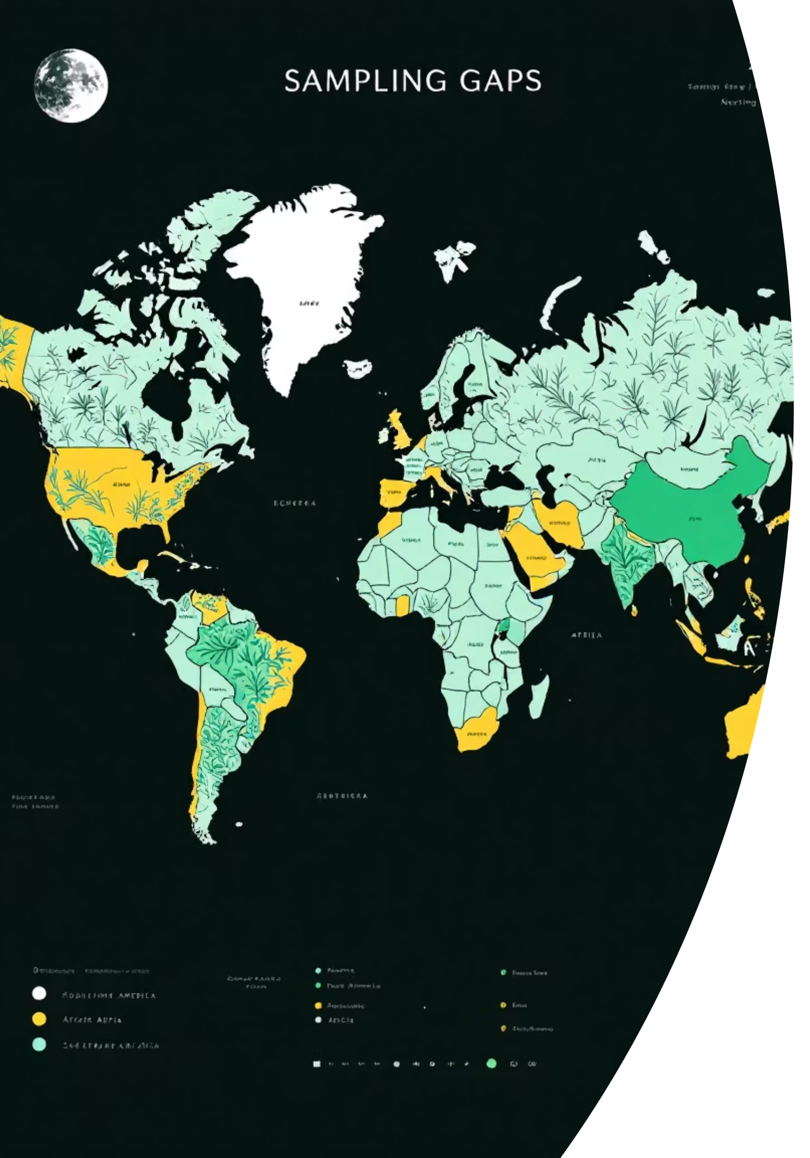
Identifying Under-Sampled Regions
Western bias: North America and Europe dominate. Under-represented regions:
Africa
South America
Southeast Asia
Implication: → Conservation planning and global biodiversity assessments may be skewed.

Slide 11
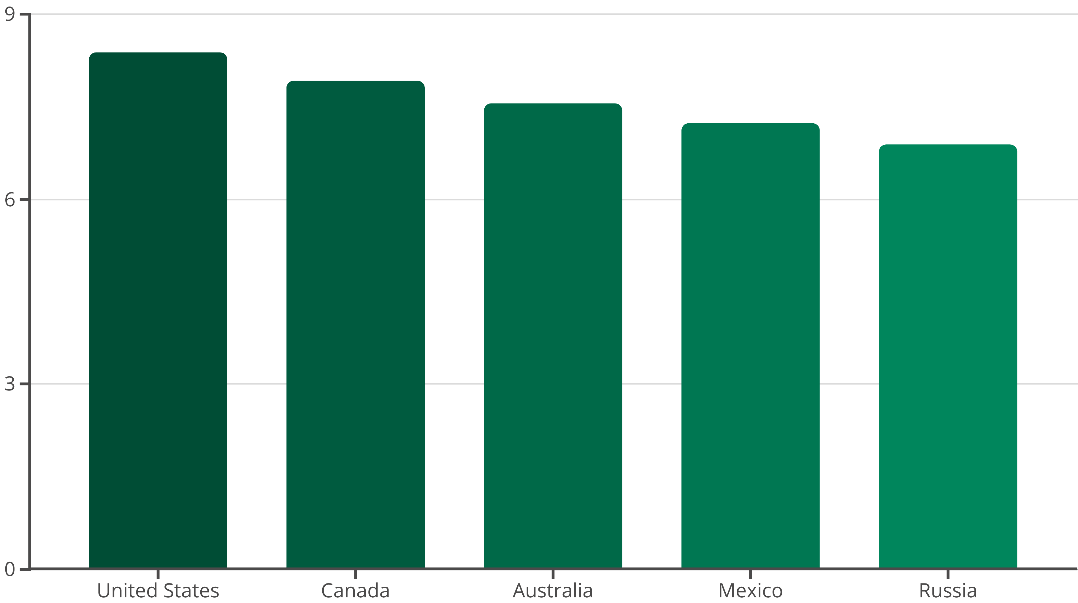
Advanced Statistical Analysis
Species Richness Estimation (Shannon Index)
Calculated for Top Countries
The Shannon Diversity Index was computed for the five countries with the highest observation counts, providing a quantitative measure of biodiversity within these regions.
United States Leads in Diversity
The USA exhibits the highest Shannon Index (~8.38), indicating rich and evenly distributed species, followed by Canada and Australia.
Richness and Evenness
This index effectively captures both the number of different species (richness) and the relative abundance of each species (evenness) in a given area.
Figure 6: Shannon Diversity Index for Top 5 Countries

Slide 12
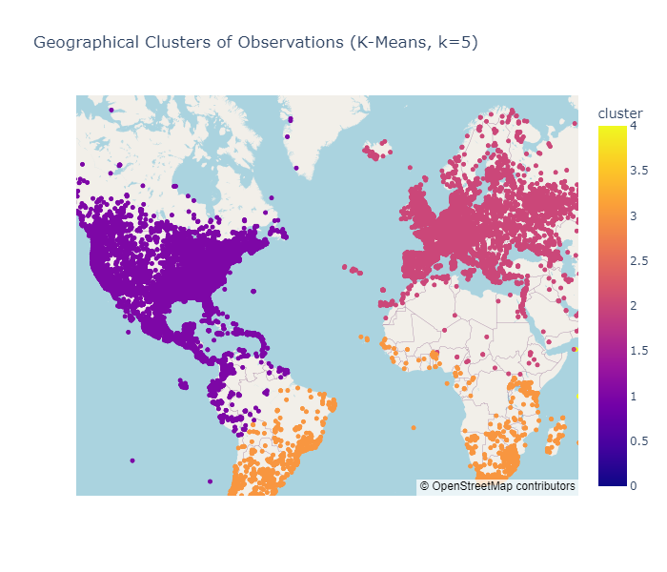
Cluster Analysis (K-Means)
To gain deeper insights into the spatial distribution of biodiversity observations, K-Means clustering was applied to the dataset.
Algorithm Application
Global Pattern Identification
Highlighting Hotspots
Applied K-Means clustering (k=5) using latitude and longitude coordinates, effectively grouping similar geographical regions.
Identified global spatial clusters that clearly align with continent-level biodiversity observation patterns.
The dataset is heavily skewed towards North America (Cluster 1) and Europe (Cluster 2), which together account for over 80% of the data.
Cluster | Centroid (Lat, Lon) | Region (Approx.) | Observations | Share
0 | -34.18, 153.33 | Australia / Oceania | ~3,170 | 6.3%
1 | 36.34, -94.83 | North America | ~29,933 | 59.9%
2 | 49.49, 15.76 | Europe | ~11,318 | 22.6%
3 | -27.55, -7.90 | South Atlantic / Africa | ~2,567 | 5.1%
4 | 27.03, 104.98 | Asia | ~3,012 | 6.0%
Figure 7: Geographical Clusters of Observations

Slide 13
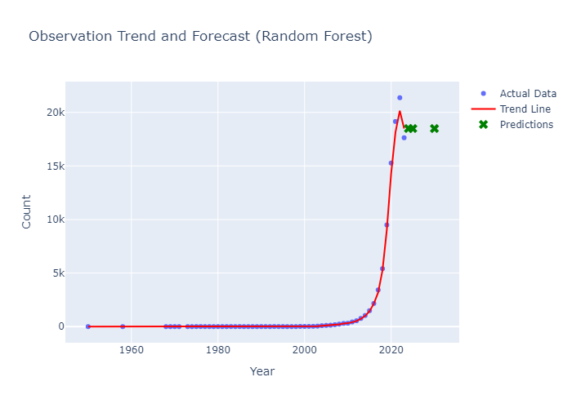
Predictive Modeling
Forecasting Future Biodiversity Observations
To forecast future observation trends, we implemented a **Random Forest Regression** model on the yearly observation counts (post-1950). This machine learning approach captures non-linear trends more effectively than simple linear models.
The model achieved an exceptional R2 score of 0.9966, indicating a near-perfect fit to the historical data. Unlike the linear model, the Random Forest model predicts a much more dynamic growth. We project the annual observation count to reach approximately 18,489 by the year 2030, reflecting the accelerating interest in biodiversity monitoring.
Model | R2 Score | MAE | RMSE
Linear Regression | 0.2841 | 2750.88 | 4091.38
Random Forest Regressor | 0.9966 | 91.23 | 281.15

Slide 14
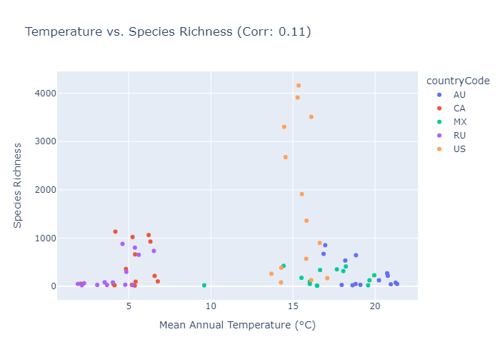
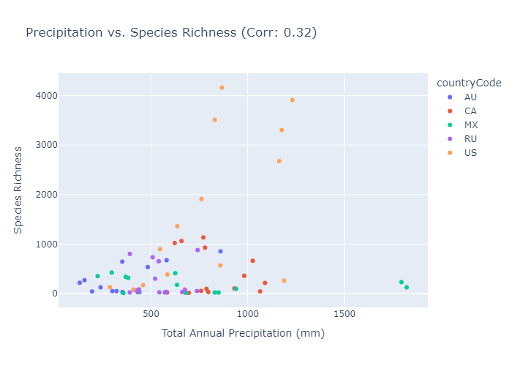
Climate Data Integration
Integrating climate data with biodiversity observations provides crucial context for understanding species distribution patterns.
Methodology
Correlation Results
Utilized Open-Meteo API for reliable climate data.
Temperature: Showed a weak positive correlation (~0.11) with observation counts.
Aggregated biodiversity records by country and year, then computed geographical centroids.
Precipitation: Exhibited a moderate positive correlation (~0.32).
Retrieved key climate variables: Mean Annual Temperature and Total Annual Precipitation for each centroid.
This suggests that regions with higher annual precipitation tend to support a greater number of observed species.
Figure 9: Correlations with Temperature & Precipitation

Slide 15

Conclusion
Comprehensive Workflow Demonstrated
Key Biodiversity Patterns Uncovered
Enhanced Research Accessibility
Successfully applied an end-to-end biodiversity analytics workflow, from data acquisition to visualization and advanced analysis.
Identified significant taxonomic, geographical, and temporal patterns within global biodiversity data, highlighting critical insights.
Developed an interactive dashboard to significantly improve data accessibility and usability for researchers and conservationists.
Dashboard Link:
https://biodiversity-dashboard.streamlit.app/

